Slide 1
BSAFE
ITERATION # 03
FYP-2 MID EVALUATION
Date: 13th April, 2023
Learn Cyber Security in and Emmersive Environment
National University of Computer and Emerging Sciences FAST Islamabad

Slide 2
Group Members
Huma Ahmed (19I-1961)
Hakim Ali (19I-2032)
Sohaib Bin Haroon (19I-1985)
Supervisors
Dr. Zainab Abaid
(Co.) Dr. Muhammad Asim

Slide 3
BSafe
“ Cyber Security Learning management system that uses the technique of ‘Immersive Learning’ to educate users of Social Engineering Attacks, and their prevention to be safe.”

Slide 4
Problem Statement
New internet users especially people from other background knowledge, do not know the security precaution that is essential to be taken during the usage of the internet.
BSafe provides an immersive environment to virtualize the Social Engineering attacks to its user, such that they can get knowledge about their mistakes, and mitigation to stop them from happening..

Slide 5
Motivation
Cybersecurity awareness mostly disregarded in community of Pakistan
Young and elder people oblivious of online safety
Easy victimization of naïve internet users
GOAL
“Protect young students and general from cyber, and social engineering attacks”

Slide 6
Project Objective
“We construct our knowledge through experience – by doing”
Learn safe practices by experiencing Social Engineering attack scenarios using lab environment
Dive in, make mistakes, Learn!
Step by step assessment of
common mistakes
exploited vulnerabilities
mitigations

Slide 7




High-Level Features
3. Attack Scenarios
Labs
1. Frontend
2. Backend
4. Testing
MODULES
User Interactive Platform
Phishing Detector
Managing User Profiles
For-example Cyber Predator
User Training
Experimentation
(opt)
FEATURES

Slide 8


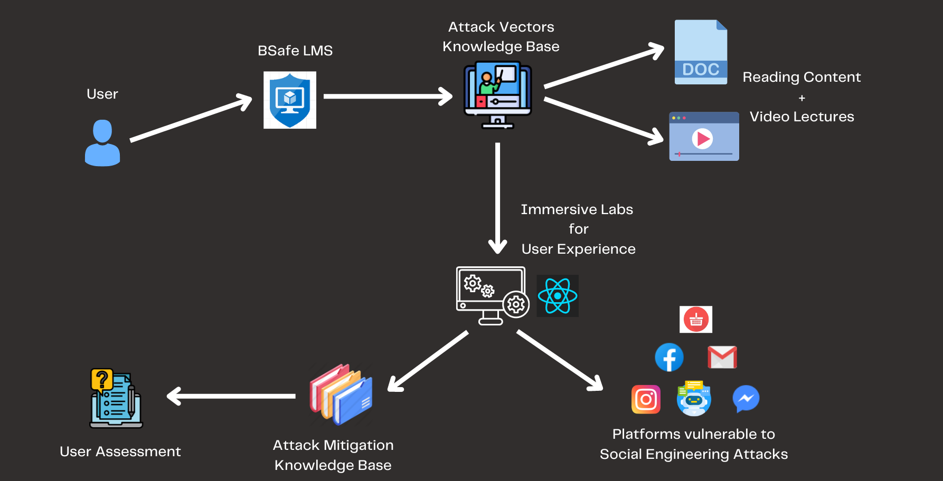

Slide 9
Iteration # 03 Workflow
Developing LMS frontend and fackend
Designing and developing user training videos
Designing and developing clones of social media platforms
Creating lab environment for users to learn
ChatBot and related attack development
Mitigation technique documents

Slide 10
Iteration # 04 Workflow
Integrating user training videos
Integrating additional chatbots
Developing user assessment quizzes
Maintaining scores
Testing and improvements

Slide 11
Technical issues of BSafe
Integration of attack components
Cross programming language compliance
Designing and developing the workflow of attacks
Creating mitigation content and video
Ensuring user learn without breaching its own privacy

Slide 12

Demo and details of implementation

Slide 13
References
https://www.cisecurity.org/insights/blog/6-educational-cybersecurity-resources-for-kids
https://www.pbs.org/wgbh/nova/labs/lab/cyber/
https://sos.fbi.gov/en/seventh-grade.html
https://www.esafety.gov.au/educators/classroom-resources/cybersmart-challenge

Slide 14
Thank You
Any Questions?

